Slide 1
F-150 ac system analysis
GDIA Internship Project Overview and Reflection
Aman Chopra
07/29/2020
Notes:
More specific title relating to what the project is about; smaller print internship; add agenda slide after title slide

Slide 2
Agenda
About Me
Business Problem & Background
Project Objectives
Data Sources
Workflow & Analysis
Next Steps
Internship Reflection

Slide 3

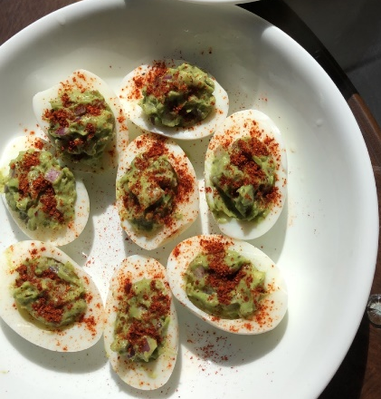
Aman Chopra
Fremont, CA -> West Lafayette, Indiana
Junior at Purdue University
B.S. Data Science/CS
Minor: Economics
Data Science Intern – Indiana Emergency Medical Services (08/19 – 12/19)
Designed backend for patient queue management system based on urgency levels, treatment times, patient population, emergencies, and walkouts.
Discovered shortages of employees due to low wages, high education costs, lack of skilled educators, and unaccommodating shift assignments.
Interests: cooking, guitar, basketball, running, camping, tutoring, road trips
Notes:
-spend less time on intro

Slide 4
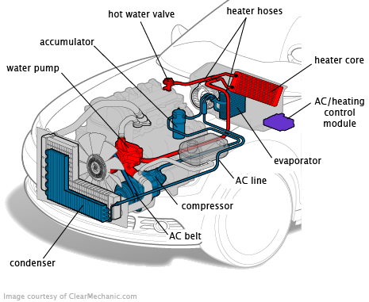
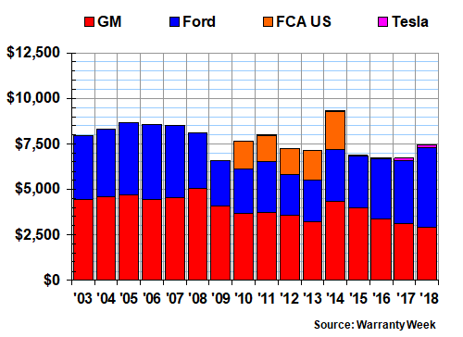
Business Problem & Background
Historically, Ford has had high warranty expenses, more than most other main U.S. auto manufacturers. Climate Control is investigating faulty compressors and other customer claims relating to the AC system, hoping to reduce warranty spending.
Possible causes for these customer complaints include driving behavior, differences in actual and requested temperature, system blockages, and other extraneous factors (season, duration of trip, etc.).
Annual U.S. Auto Manufacturers Claims Paid (in millions)
Source: Clear Mechanic

Slide 5
Objectives
Advised by climate control to analyze the following in F-150s to gain insights into customer complaints regarding the AC system.
Driving behavior patterns.
Difference between actual and requested temperature.
Duration and frequency of negative temperature intervals.
Notes:
Mention icing issue which is why we are studying neg temp intervals;

Slide 6
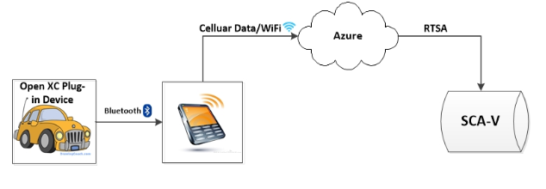
Data Sources
BDD utilizes a device connected via the OBD port to collect high-frequency data from the vehicle CAN bus.
Contains over 3,000 vehicles since January 2014 actively transmitting at a frequency of thousands of signals/ms.
Data characteristics include VIN, vehicle characteristics, trip information, battery status, HVAC status, raw vehicle data, driver behavior, engine & fuel status, etc.

Slide 7
Workflow
Identify VIN Selection Criteria
Determine Signals of Interest
Pull Data
Exploratory Analysis
Scale Study to Other Vehicle Types
1
2
3
4
5

Slide 8
1. F-150 Selection Criteria
At least 30 days worth of recorded data transfers.
Preferable to select fewer vehicles with more frequent transfers, rather than more vehicles with less transfers.
2018 & 2019 F-150s.
Transfer timestamps during summer months (May - August).
Variable displacement compressors.
64 2018 F-150s
784 F-150 VINs from BDD
100 2019 F-150s

Slide 9

2. Signal Availability
2018-2019 F-150 DBCs contain ~1600 total signals.
Engine
Veh_V_ActlEng
EngAout_N_Actl
Transmission
GearLvrPos_D_Actl
Ignition_Status
Behavior
DriverWindowPosition
RearPassWindowPos
PassWindowPosition
HVAC
AirAmb_Te_ActlFilt
Outside_Air_Temp_Stat
AmbTempImpr
HvacEvap_Te_Actl
HvacEvap_Te_Rq
AirCondFluidHi_P_Actl
CoolantFanStepAct
HvacAirCond_B_Rq
HvacBlwrFront_D_Stat
Brake
BrkTot_Tq_Actl
Driving Info
VehLong2_A_Actl
ApedPos_Pc_ActlArb
OdometerMasterValue
Battery Info
BattULo_U_Actl
Notes:
State that signals are determined based on objectives from slide 4; temps in Fahrenheit; box w/ question mark showing signals that are not broadcasted or signals that we don’t know about that could impacting climate system

Slide 10
3. Pulling Data & Preprocessing
Pivot Table Construction
Defining Trips
Quality Control & Imputation
Aggregation by mean for numerical features and mode for categorical features.
Timestamps rounded to nearest second.
Interval where the difference between timestamp < 30 minutes.
Trips < 30 seconds or > 12 hours filtered out.
Combination of forward filling and KNN.
Utilized beeline with HIVE to query MASTER table from BDD.
Tested preprocessing algorithms with 1 VIN to avoid expensive overhead from scaling.
Notes:
After validating preprocessing steps, Python script written to streamline preprocessing & construct pivot tables for batches of VINs.

Slide 11
4. Exploratory Analysis
Analyze the following:
Time intervals during which the actual temp. is below 0°C.
What is the duration that the internal temp. of the compressor is below 0°C?
How often is the internal temp. below 0°C?
Difference in actual temperature and requested temperature.

Slide 12
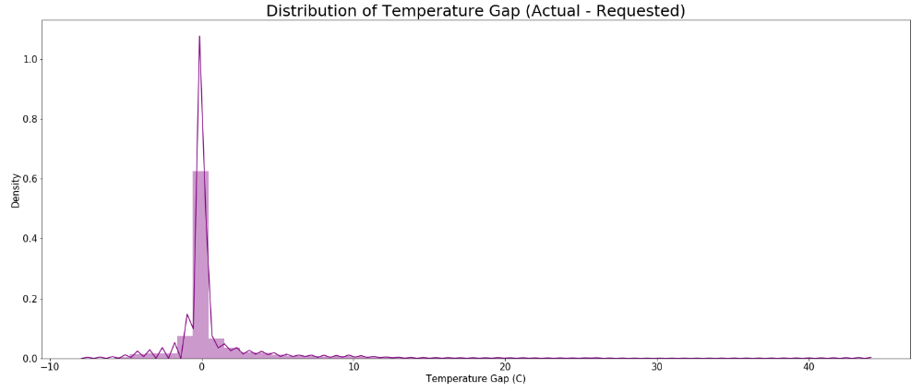
Difference in Actual and Requested Temperature
Notes:
Fix chart x label

Slide 13
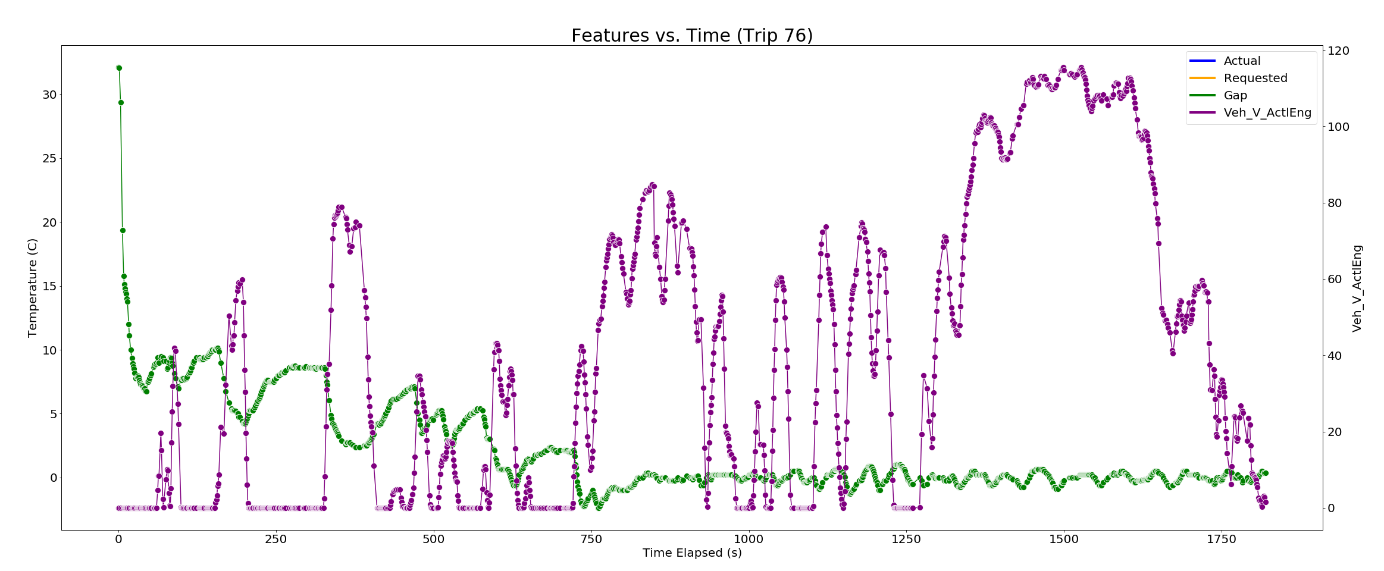
Difference in Actual and Requested Temperature
Most large gaps occur at beginning of trip. Since the vehicle has been off since the last trip, the AC system can take time to lower the interior temperature which is probably high during summer months.
Gaps seem to increase during times when the vehicle idling and stabilize as the trip progresses.
Notes:
arrows
After seeing these patterns, this led me to
defining 4 key events.

Slide 14
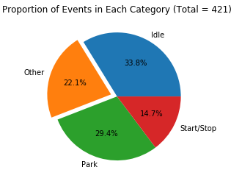
Difference in Actual and Requested Temperature
Trips were segmented further into events, defined by an interval where the speed changes from greater than 5 km/hr to less than 5 km/hr. This allowed to focus on smaller intervals with abnormal gaps.
Only selected events with average temperature gap greater than 5°C and durations more than 30 seconds.
Categorized events based on the following labels:
Park (gear position in park)
Start/Stop (0 <= rpm < 500, speed < 2 km/hr)
Idle (500 <= rpm < 1000, speed < 2 km/hr)
Other

Slide 15
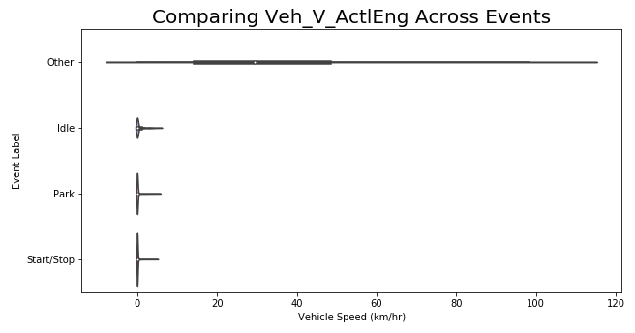
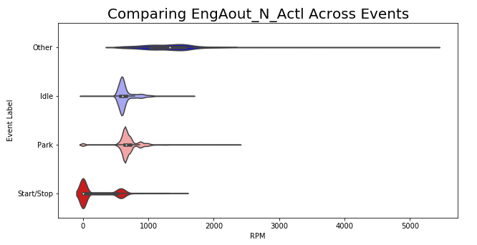
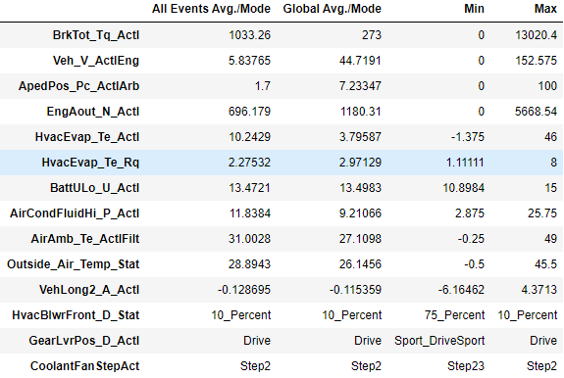
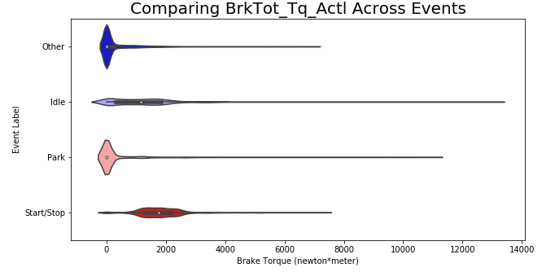
Difference in Actual and Requested Temperature
On average, temperature gaps are small ~ 2°C, and they appear mostly during park, idling, and start/stop events. Code in Jupyter Notebooks is scalable to more VINs and allows for a closer look of these events.
Notes:
Throw in appendix; compare distribution across different events for a couple features instead of pic above.
This is more of a POC. With more data, we are able to segment trips into events and segement into these groups and look more closely at these events versus the whoel trip. Code is reproducable and scalable

Slide 16
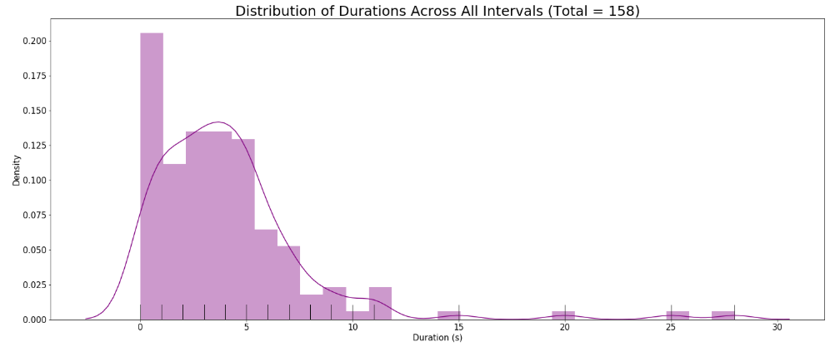
Negative Temperature Intervals
Identified by locating continuous intervals where actual temperature <= 0°C.

Slide 17
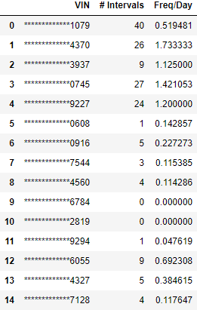
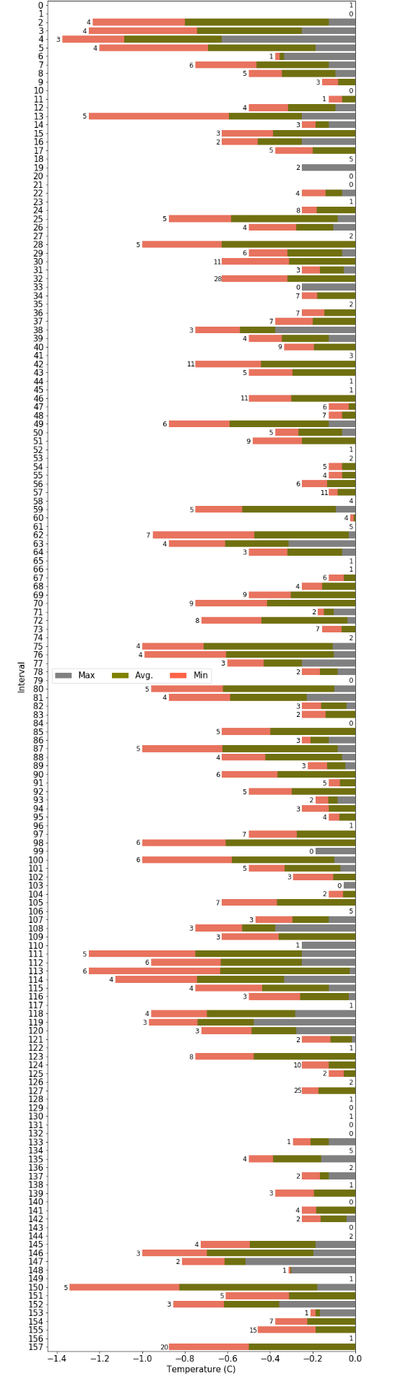
Negative Temperature Intervals
Temperature Reached/Interval (Labels Indicate Duration in Seconds)
Negative temperature intervals occur every 2 days on average, lasting for ~4.18 seconds, with some as long as 28 seconds.
Notes:
Add time elap dist to appendix.

Slide 18
What’s Next?
Clustering events/intervals with similar signal values.
Utilizing different search methods (binary segmentation, dynamic programming, window-based) for point detection to classify trips and events with more accuracy.
Gain better understanding of transfer frequency from Data Ops. Select signals with more consistent transfer rates and better quality.
Scale study to more VINs, ~100+.

Slide 19
Internship Objectives & Tools Leveraged
Be able to participate in holistic projects where I can learn and employ new data science skills, while still challenging myself. Work with large datasets, leverage techniques in ML and data mining, and develop robust models.
Analysis of Evaporator Request vs. Status:
Create a scalable, Python-based process to pull, manipulate and analysis data at the vehicle (VIN) level.
Provide insights from data analysis about frequency of temperature differences in specific vehicle line.
Leverage findings from previous projects, as well as completing independent research.
Work with other GDIA team members to codify processes, QA results.
Reach out to business partner for questions and present findings.
Give back to Ford and the community and provide high-quality work.
Python
Hive
Spark
Hadoop

Slide 20

Ford Truths
Proactively reached out to Climate Control, updating them on progress.
Followed up consistently after meetings, summarizing key points.
Met with intern from IT to share experience & opportunities in GDIA.
Ensured to respect data privacy and filtered out most digits of VIN in presentations.
Initiated meetings with team members to learn more about their projects and establish relationship.
Deeply investigated business needs, and did not hesitate to ask questions.
Leveraged resources on Ford wiki and team members to gain domain knowledge when working with HPC, Spark, and DZ.
Prioritized optimization in code to allow for high scalability.
Found alternatives to complete tasks despite challenges with data access, DZ, or Spark configurations.
Optimistic about new assignments regardless of change of scope or added complexity.
Frequently set personal goals to foster learning.
Organized GitHub repository and consistently pushed updates.
Organized consistent meetings with fellow intern and team members to build a network despite the virtual internship experience.
Followed up to hear and address feedback.
Notes:
- Add acknolwdgemonts

Slide 21

Acknowledgements
Climate Control: Kevin Swenskowski, Luke McDermott, Curtis Jones, Patrick Floyd, Alan Gutowski, Zhengyu Liu.
Connected Vehicle Analytics: Sheida Malekpour, Mahtab Fard, Tom Montgomery, Jia Luo, Adam Kowalski, Jarryd Calhoun, and team.
FCGs/Mentors: Henry Berkemeier, Telisha Everett.
Fellow Interns: Robert Frenken, Abhishek Jani.

Slide 22
Appendix

Slide 23
Notebooks w/ Analysis: https://github.ford.com/MFARD/BDD-Climate-Control

Slide 24
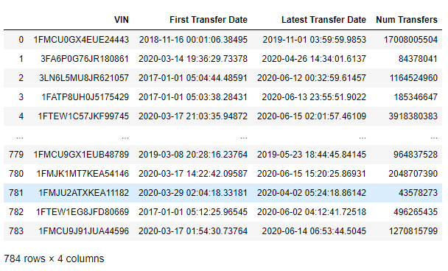
F-150 Selection
Extract all 784 F-150 VINs from BDD.

Slide 25
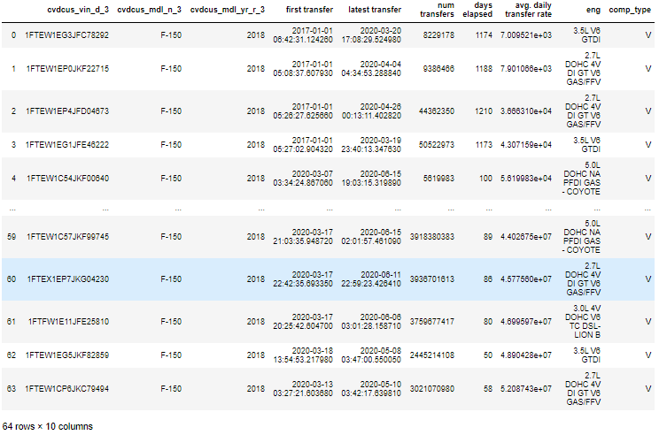
F-150 Selection
64 2018 F-150s subset based on selection criteria.

Slide 26
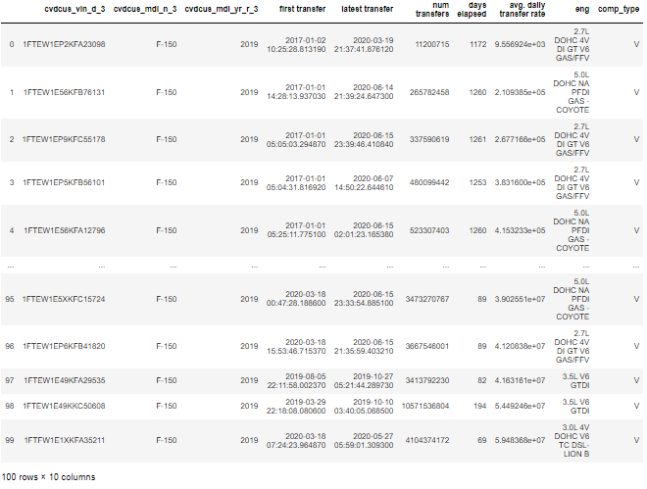
F-150 Selection
100 2019 F-150s subset based on selection criteria.

Slide 27
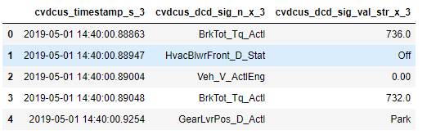
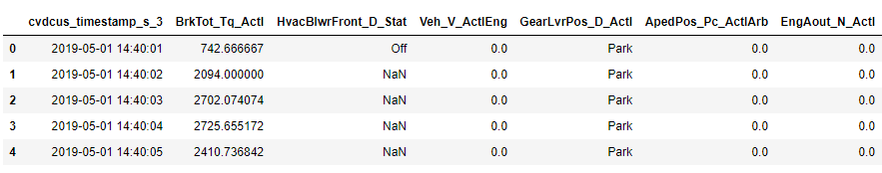
Pivot Table Construction
Timestamps rounded to nearest minute.
Values aggregated by mean for numerical signals and mode for categorical signals.

Slide 28
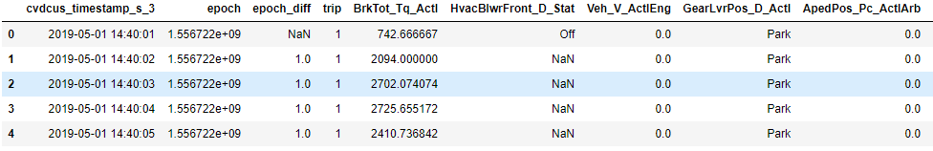
Defining Trips
Trip: an interval where the difference between epoch is < 1800 (30 minutes).
Trips with durations less than 60 seconds or greater than 12 hours filtered out.

Slide 29
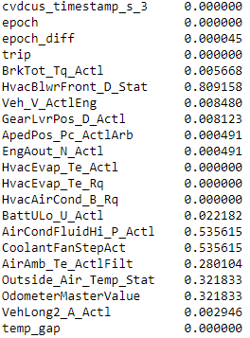
Quality Control & Imputation
Proportion of Missing Values

Slide 30
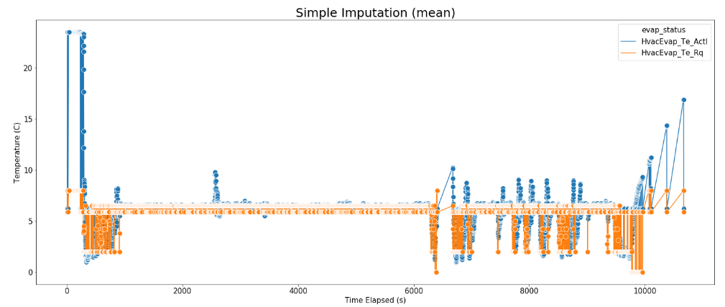
Quality Control & Imputation

Slide 31
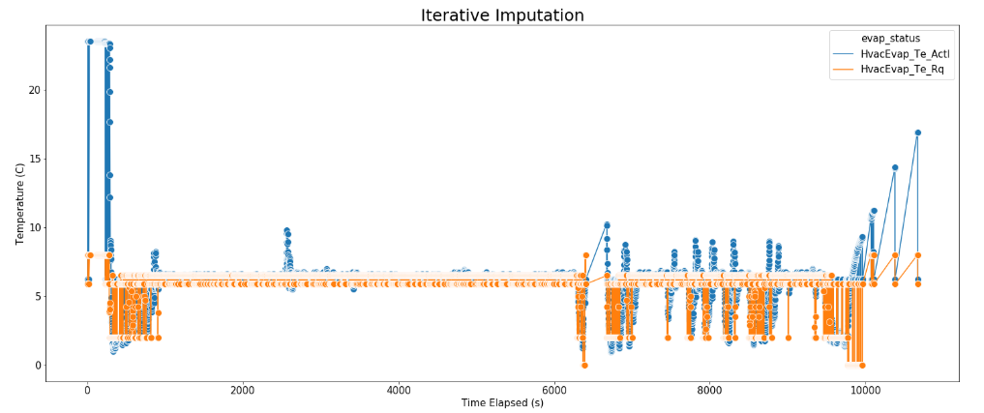
Quality Control & Imputation
Notes:
-Add plot for no imputation, combine in one slide, only need small interval of time
-spend less time on preprocessing, throw extras in appendix
-only keep slide 15

Slide 32
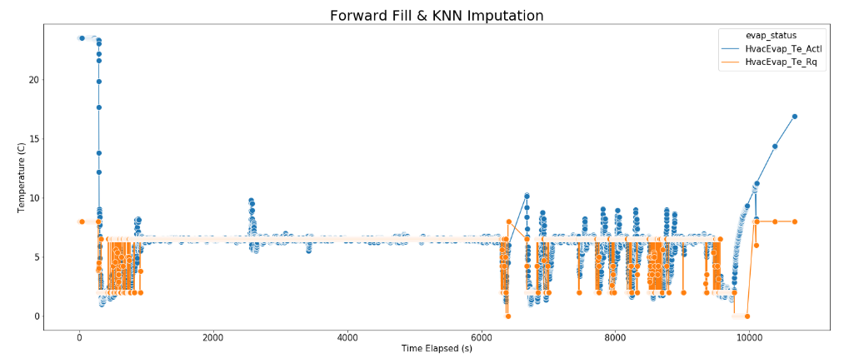
Quality Control & Imputation

Slide 33
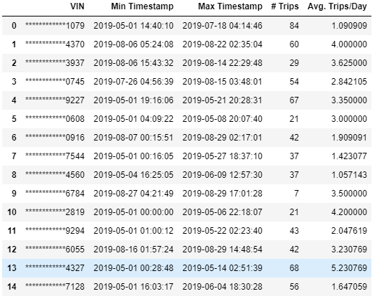
4. Exploratory Analysis
After validating preprocessing steps, Python script written to streamline preprocessing & construct pivot tables for batches of VINs.

Slide 34
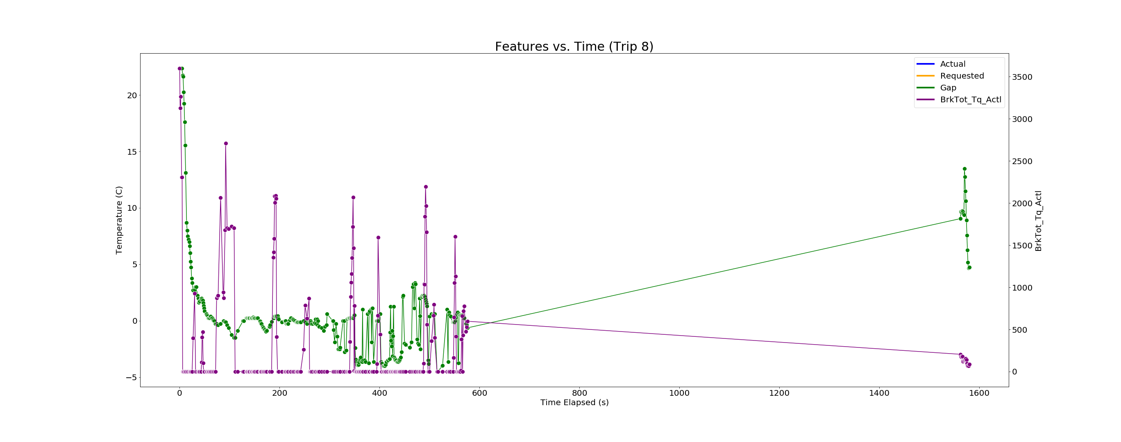
Difference in Actual and Requested Temperature
Notes:
Slides 19-21. pick one plot that contains start/stop events, idling moments, etc..

Slide 35
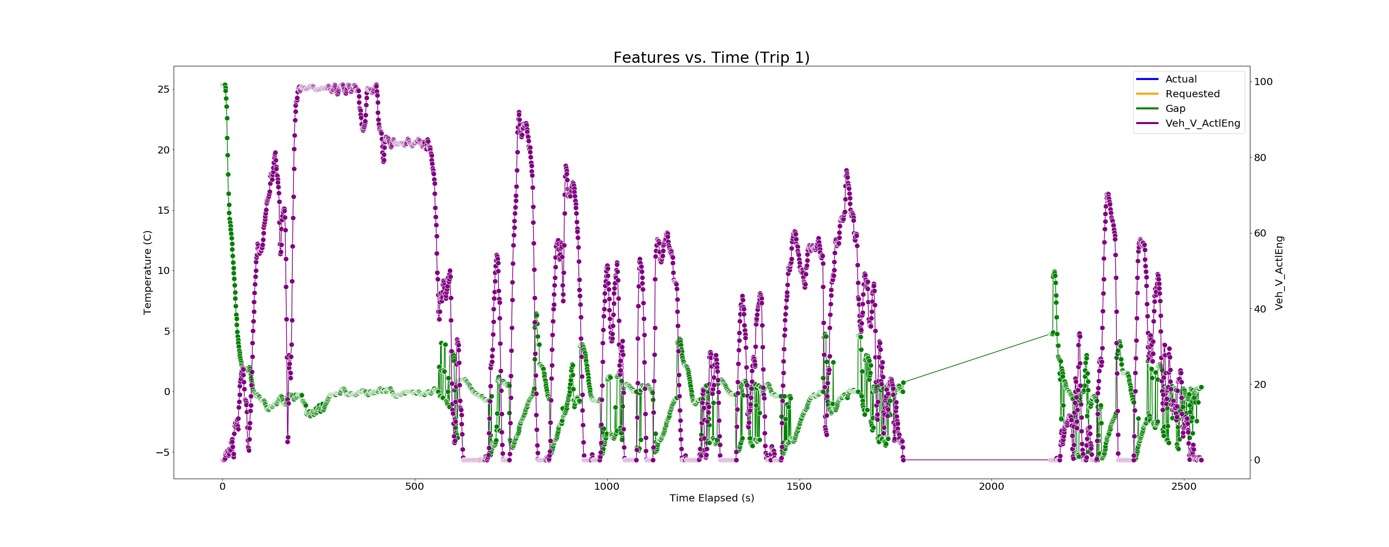
Difference in Actual and Requested Temperature

Slide 36
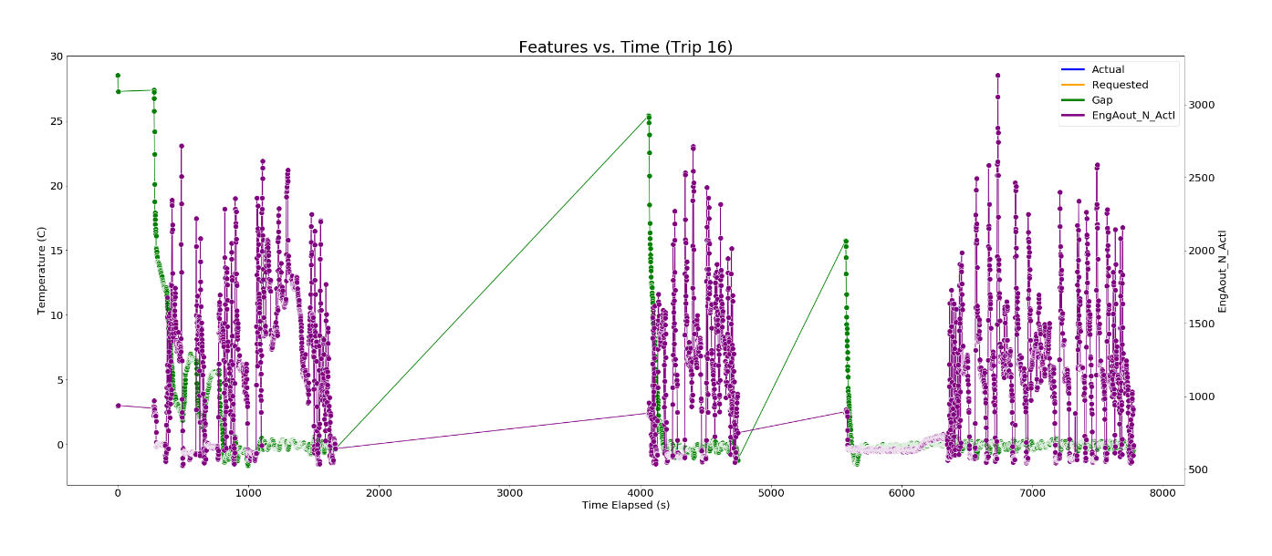
Difference in Actual and Requested Temperature
Notes:
-bigger fontsize
-1 plot highlighting all the points from slide 22, add arrows to
DELETe

Slide 37
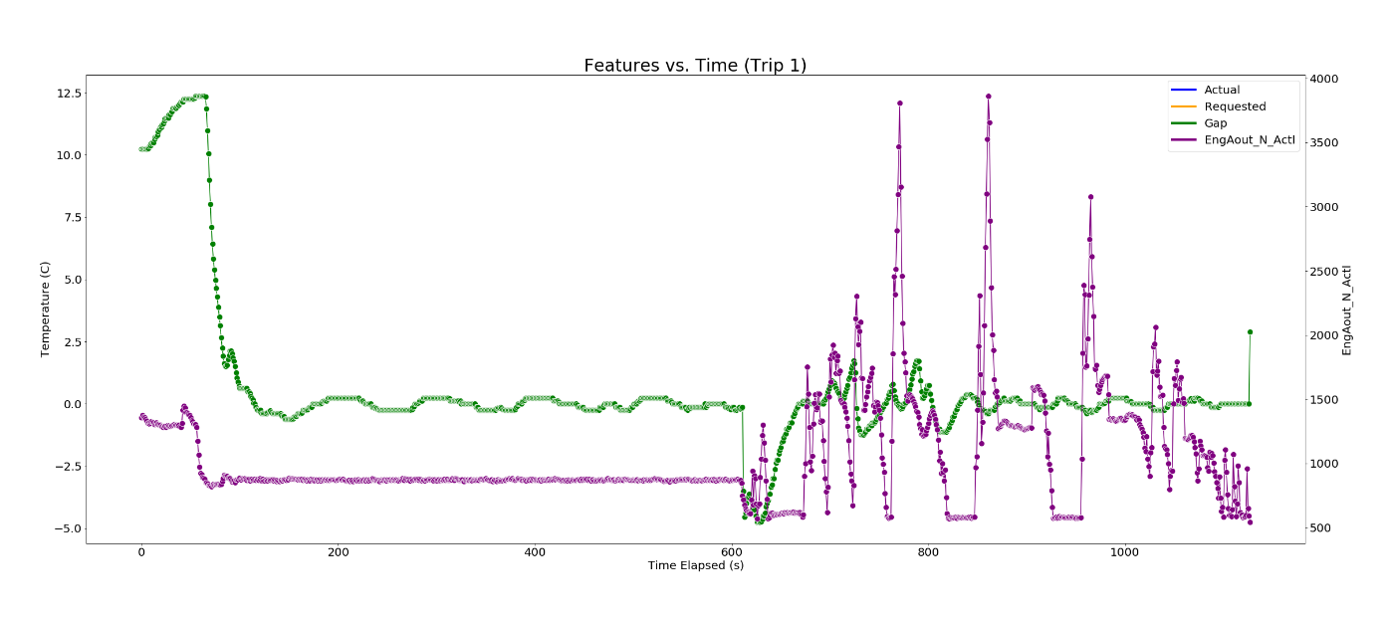
Difference in Actual and Requested Temperature
Notes:
-bigger fontsize
-1 plot highlighting all the points from slide 22, add arrows to
DELETe

Slide 38
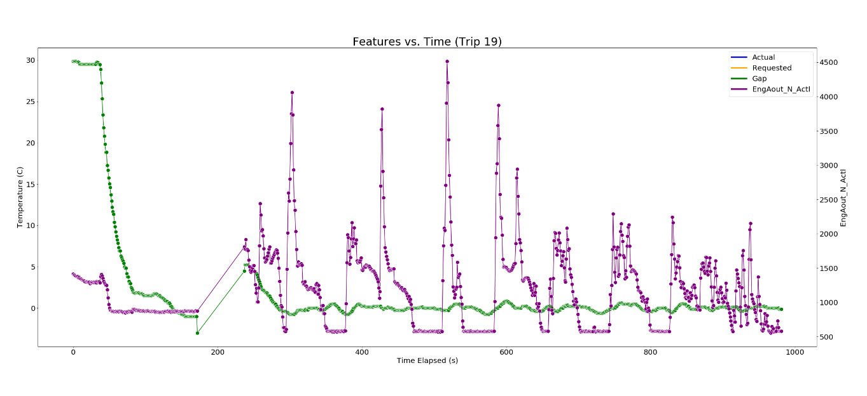
Difference in Actual and Requested Temperature
Notes:
-bigger fontsize
-1 plot highlighting all the points from slide 22, add arrows to
DELETe

Slide 39
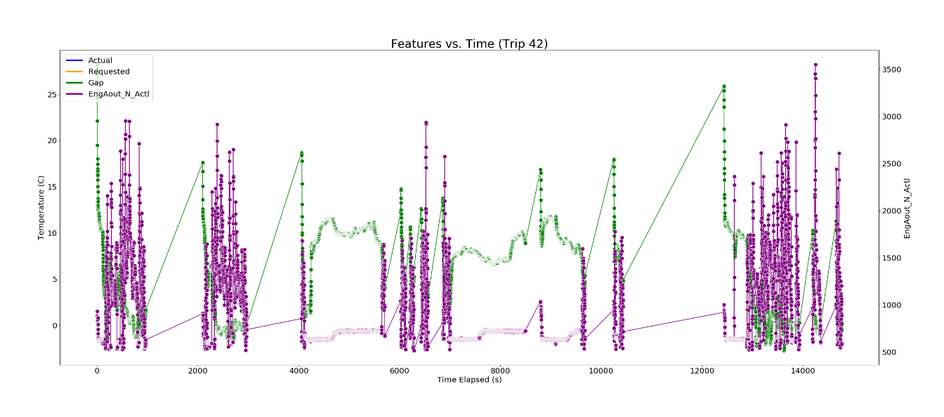
Difference in Actual and Requested Temperature
Notes:
-bigger fontsize
-1 plot highlighting all the points from slide 22, add arrows to
DELETe

Slide 40
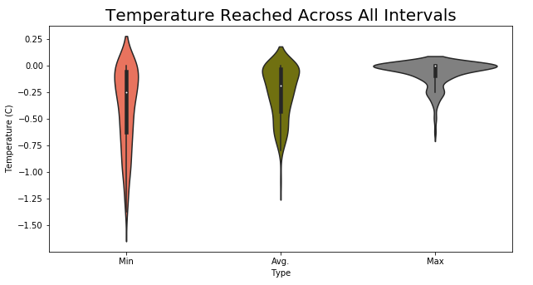
Negative Temperature Intervals
Notes:
-remove vilion
-think about what plots are needed vs which would go in appendix
-frequency of occurrence. Which vins in particular have more neg temp intervals? Replace 28-30 with this
Combine intervals where time elap between intervals I

Slide 41
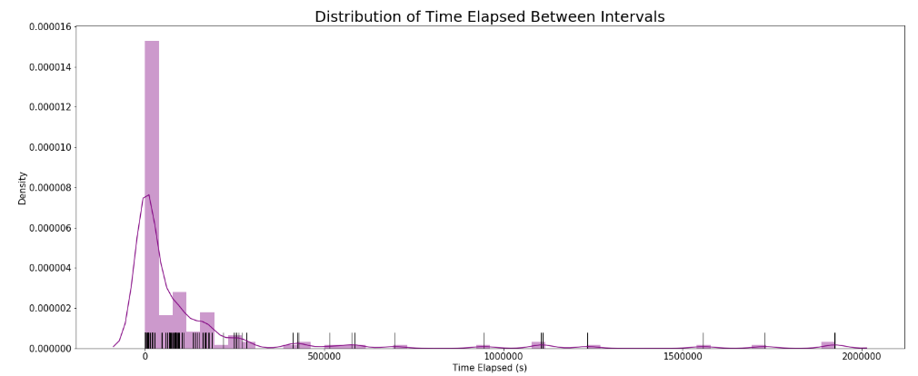
Negative Temperature Intervals

Slide 42
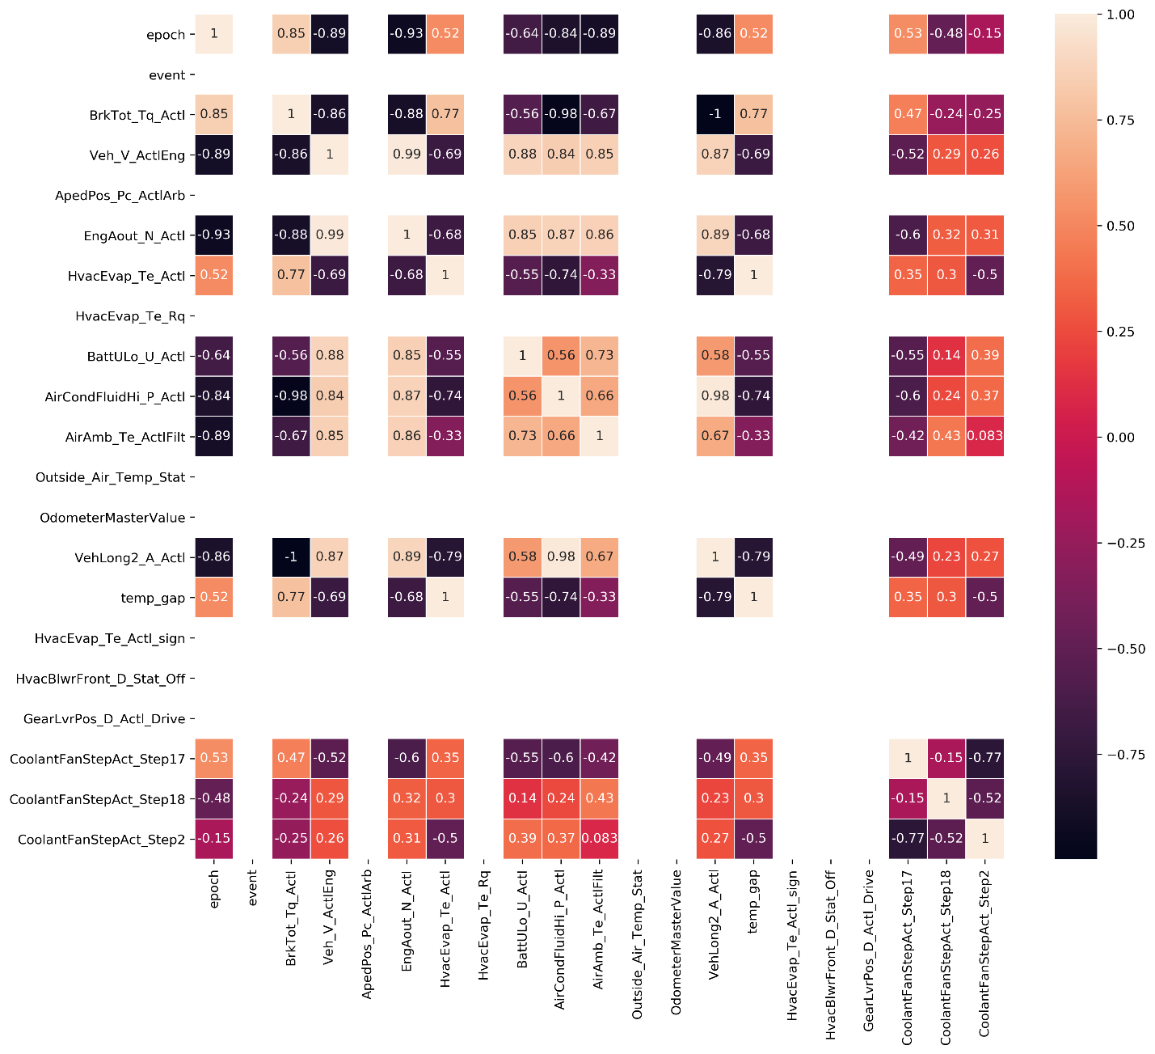
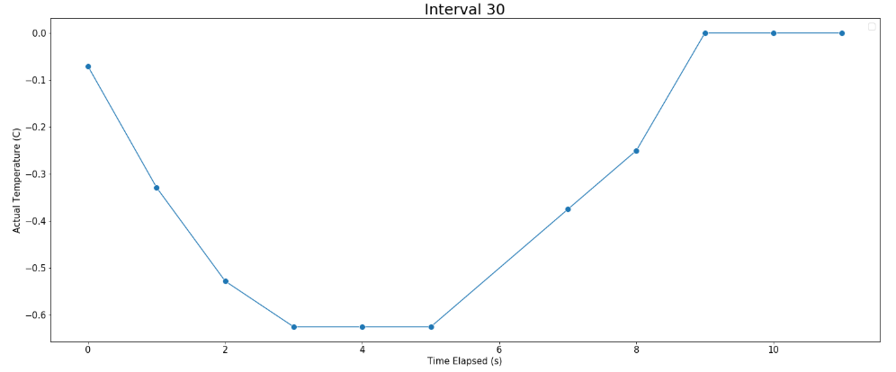
Negative Temperature Intervals
Most concerning intervals are those reaching average low temperatures for long durations: 30, 42, 157.
Notes:
-28-30. are all of them needed?
Ac pressure charge

Slide 43
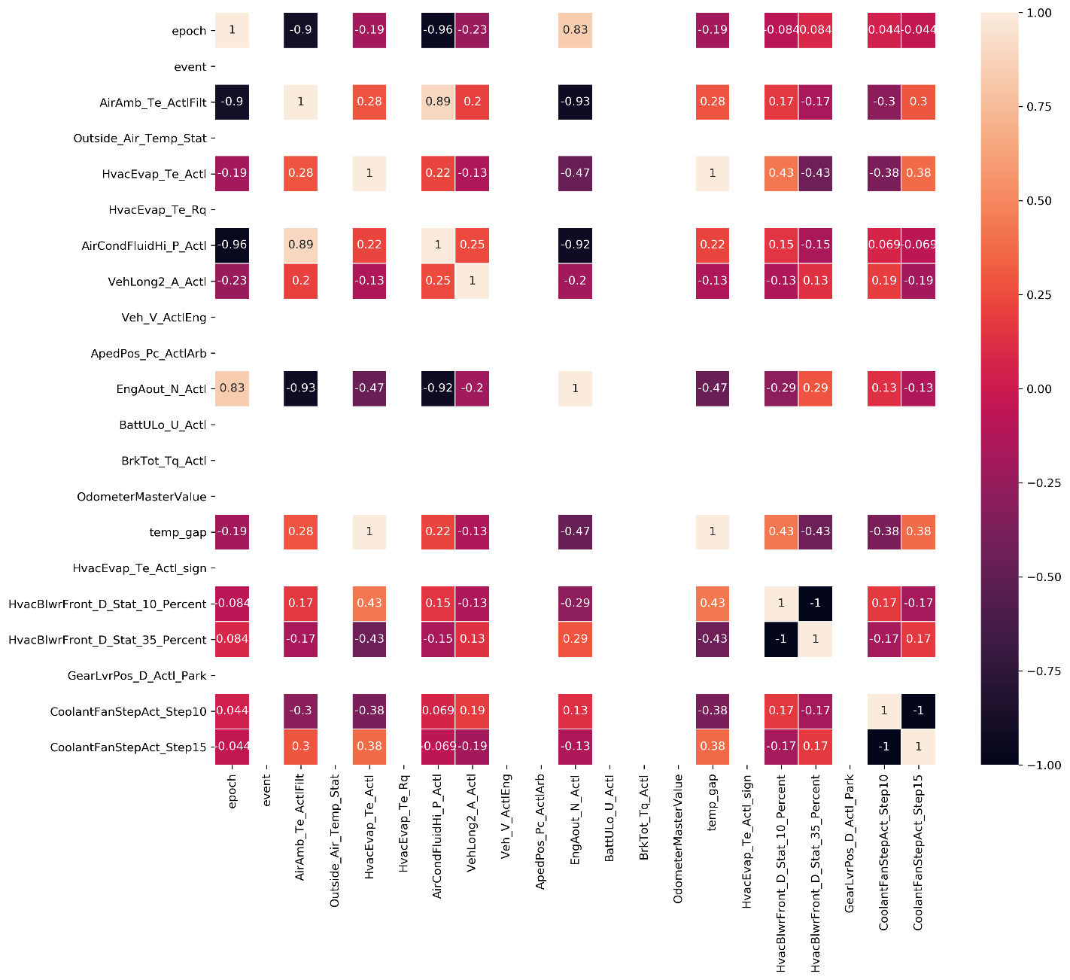
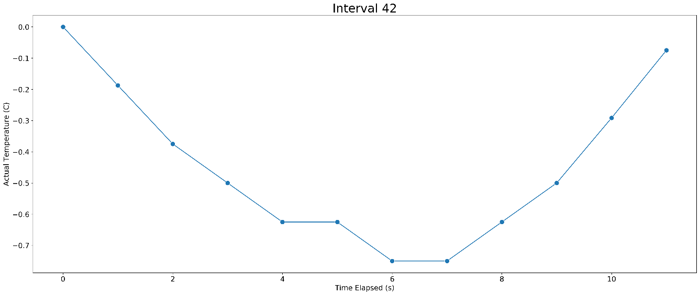
Negative Temperature Intervals

Slide 44
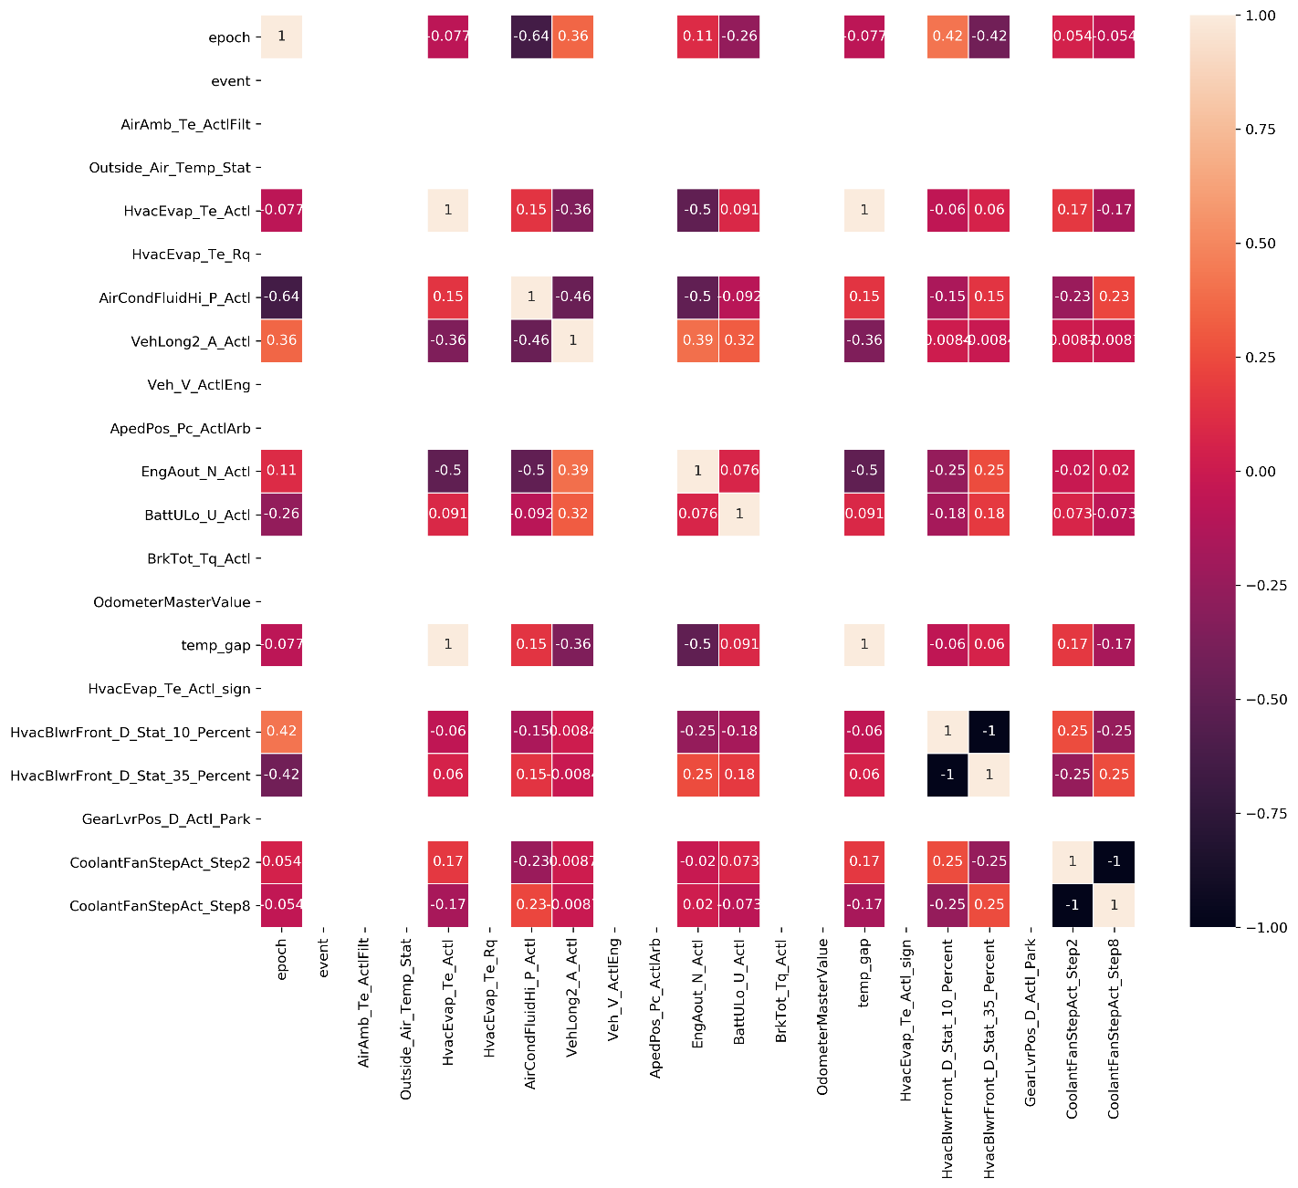
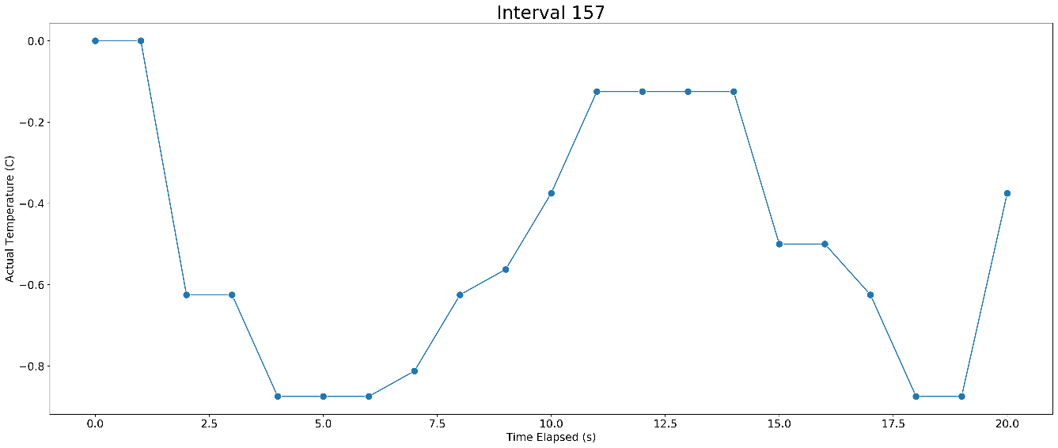
Negative Temperature Intervals

Slide 45
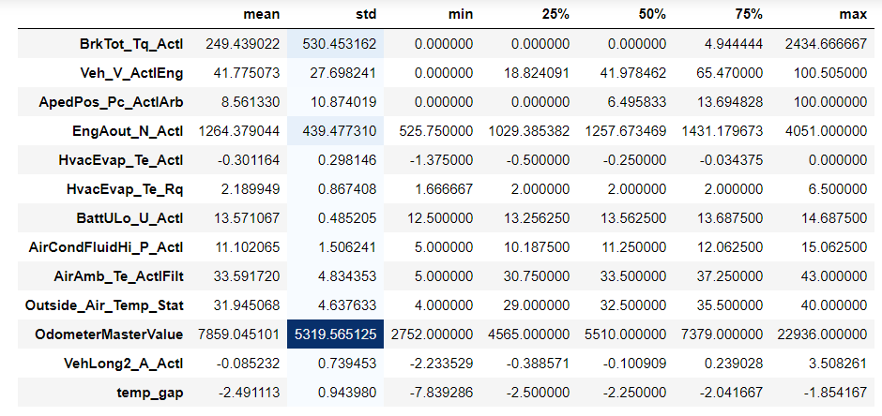
Negative Temperature Intervals

Slide 46
Challenges
This study only considers only 15 2019 F-150s, a small proportion among the ~1 million F-150s sold each year.
CAN signals transmitted at different frequencies. Imputation naïve as most signals were forward filled.
Analysis does not consider interactions between variables. Simply observing linear correlations may not be sufficient to draw most accurate conclusions.
Limited knowledge of signals makes interpretation difficult.
Lack of RECIRC signals, which could have provided more information about cabin temperature air flow.
Limited time.

